Slide 1
Simple Storage Service – S3

Slide 2
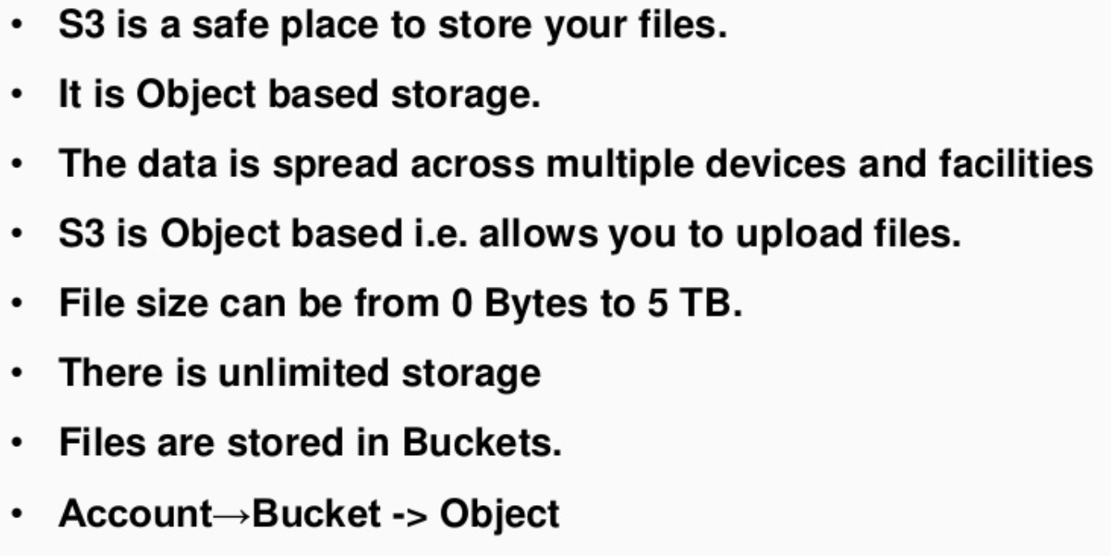
S3 – Simple Storage Service

Slide 3
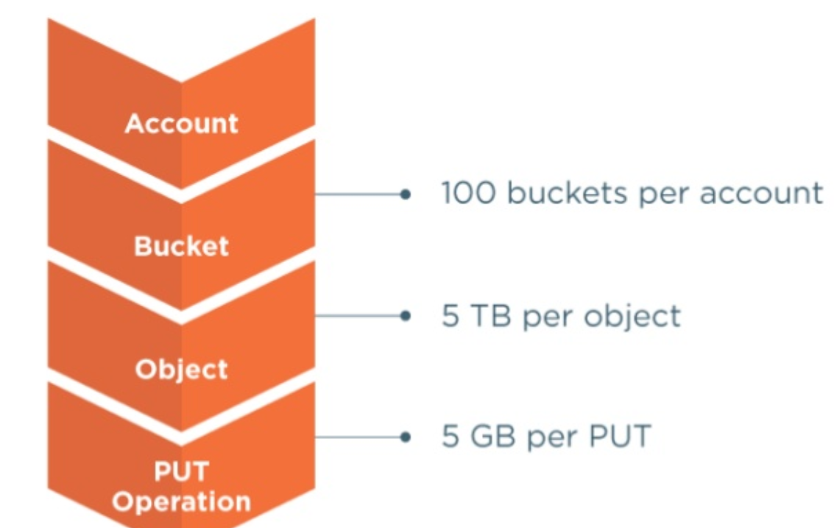
S3 – Simple Storage Service

Slide 4
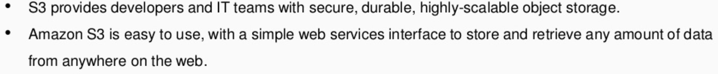
S3 – Simple Storage Service

Slide 5
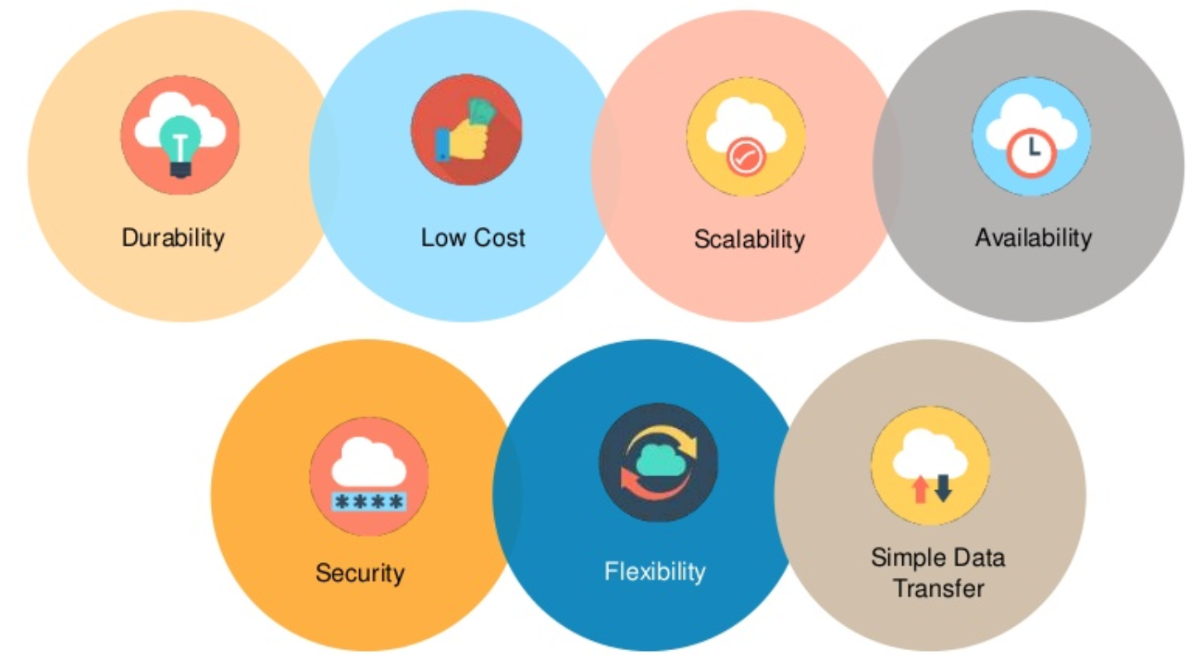
S3 – Benefits

Slide 6
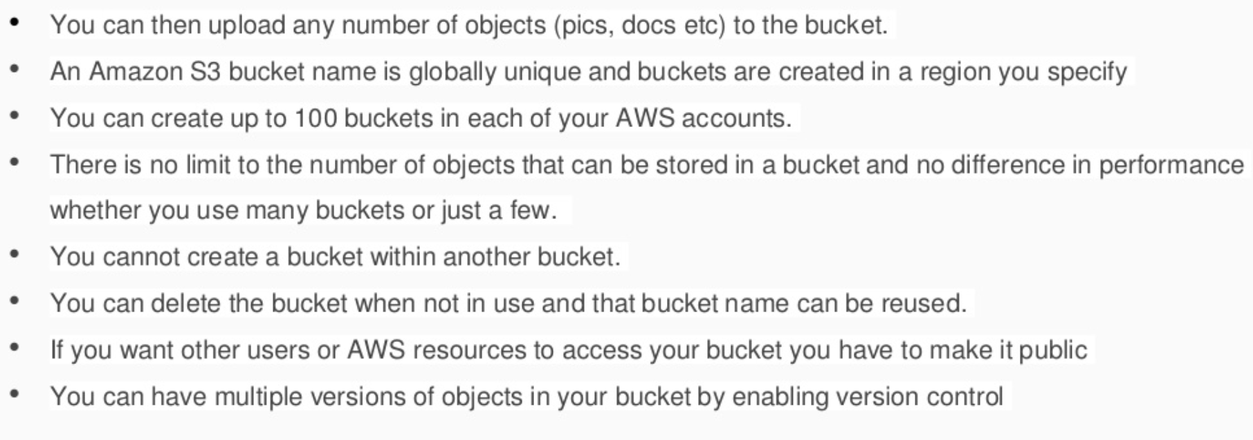
S3 – Buckets

Slide 7
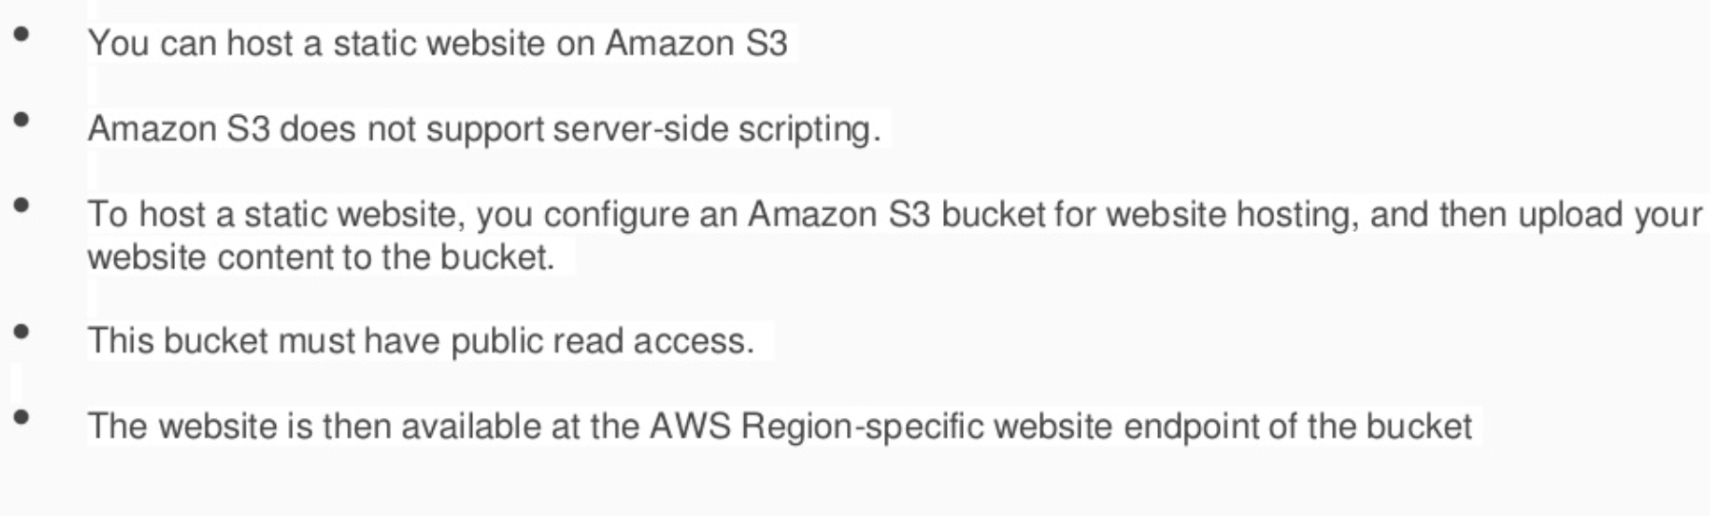
S3 – Static Web hosting

Slide 8
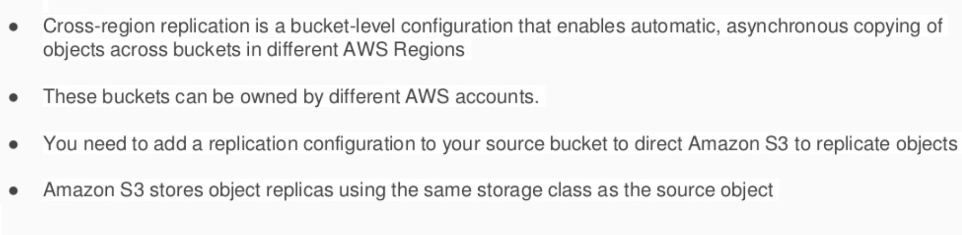
S3 – Cross Region Replication

Slide 9
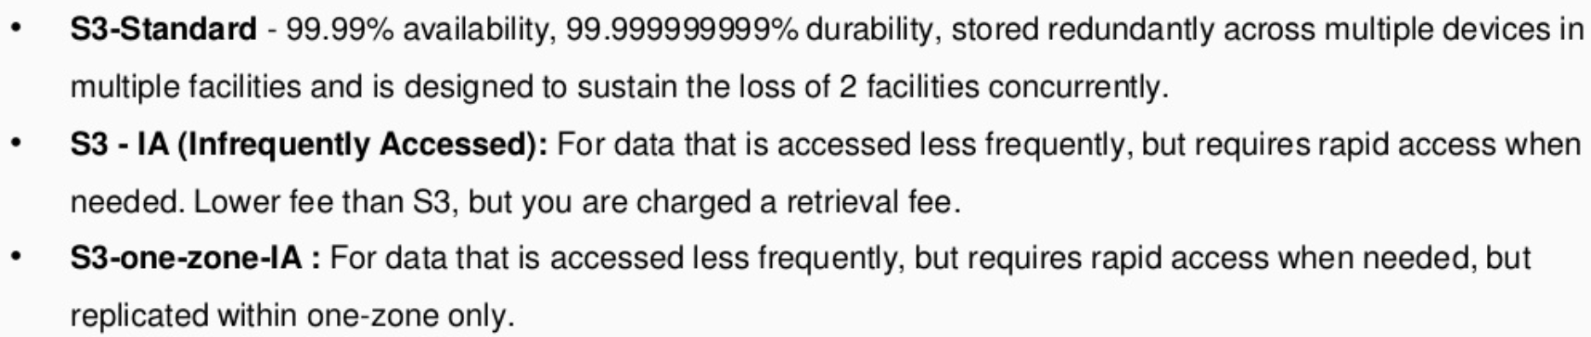
S3 – Storage Classes

Slide 10
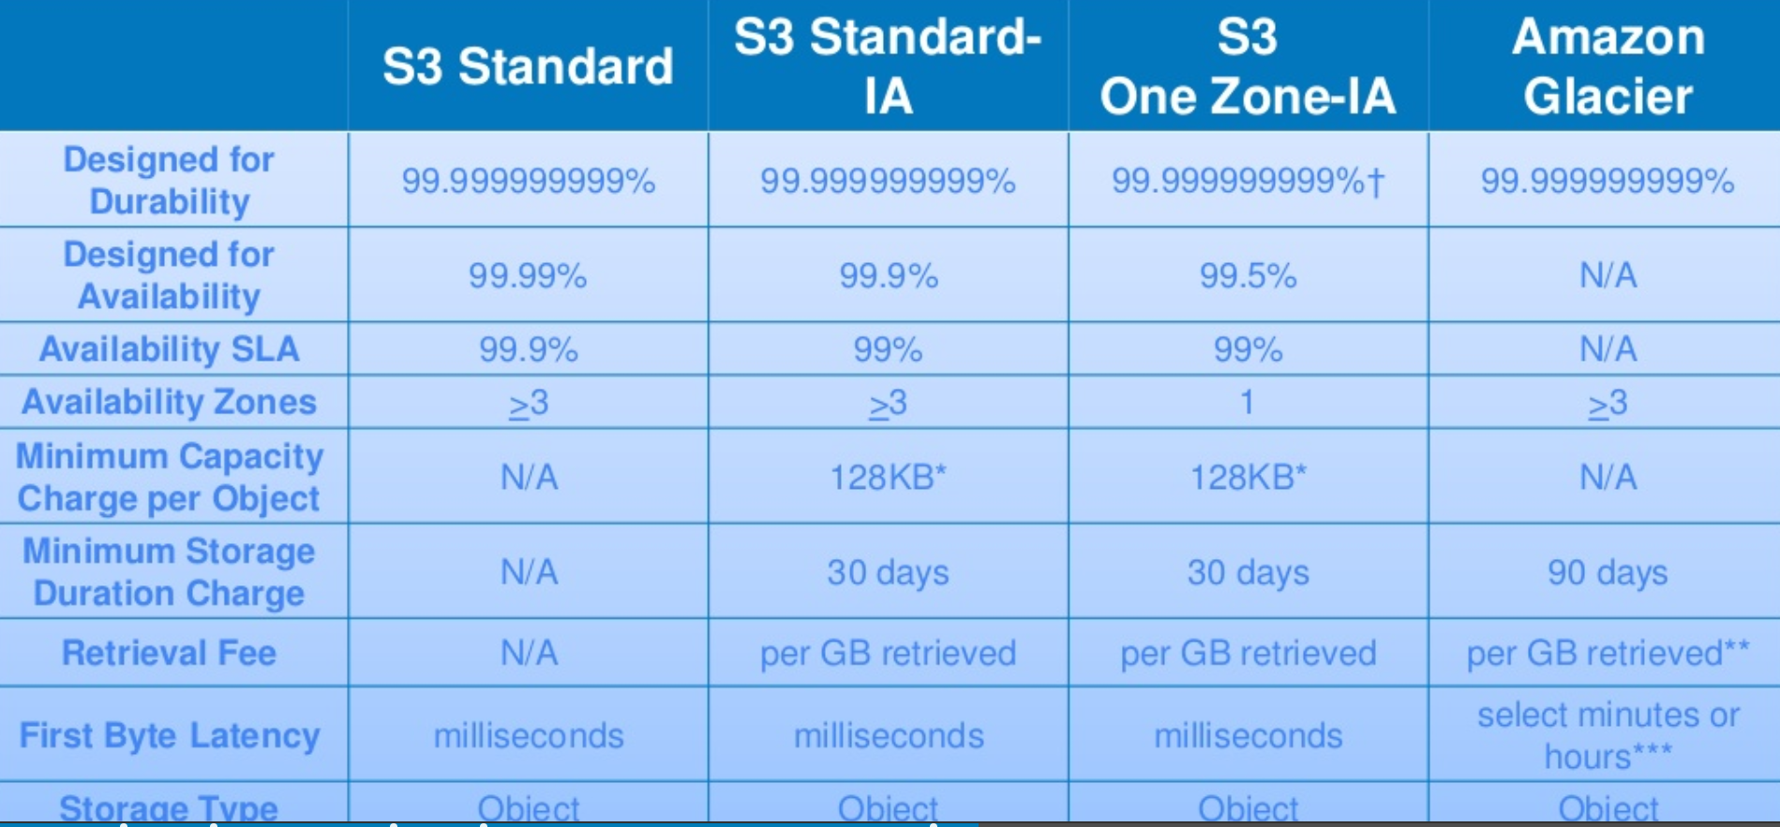
S3 – Storage Class Comparison

Slide 11
S3 – Glacier
Archives: In Amazon Glacier, data is stored in Archives. An Archive can contain up to
40TB of data. And we can have unlimited number of archives
Vaults: Vaults are containers for Archives. Each Amazon Account can have up to 1000 vaults.
After requesting for data three to Five hours later, the Amazon Glacier object is copied to Amazon S3 RRS/One-zone IA

Slide 12
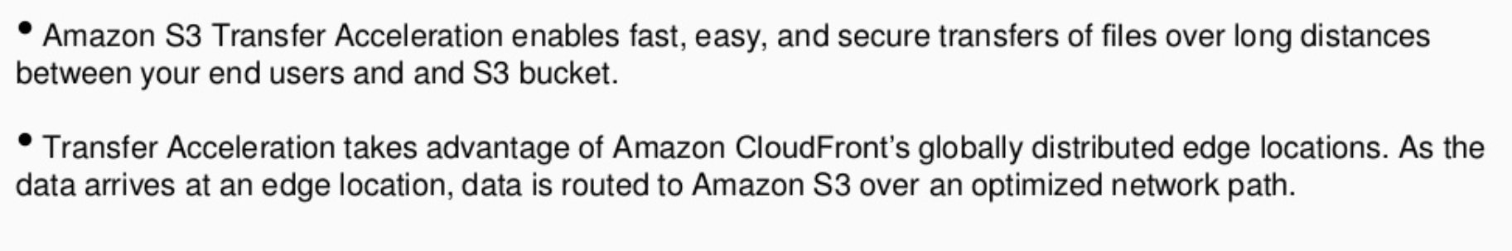
S3 – Transfer Acceleration

Slide 13
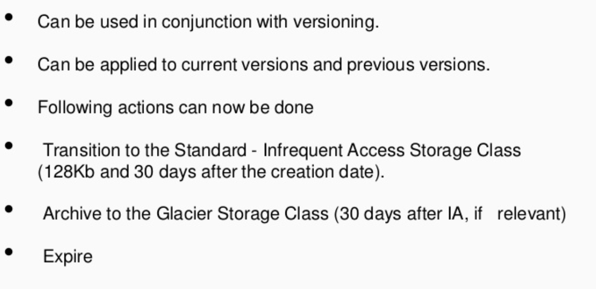
S3 – Life Cycle Management

Slide 14
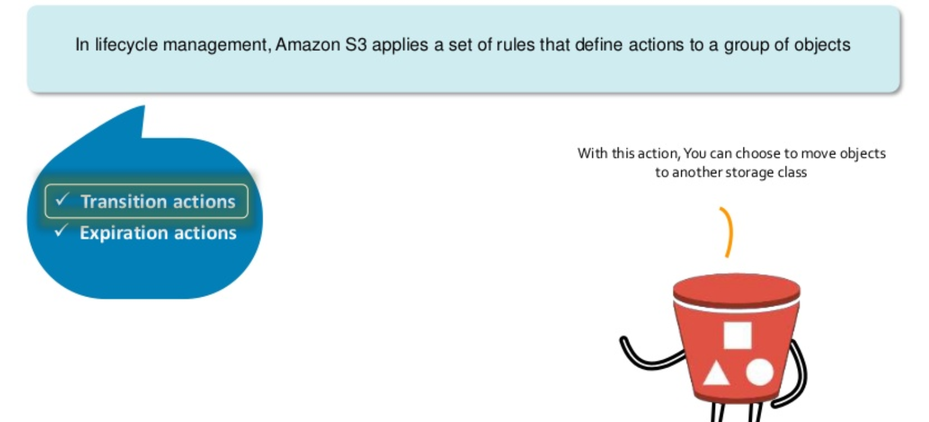
S3 – Life Cycle Management

Slide 15
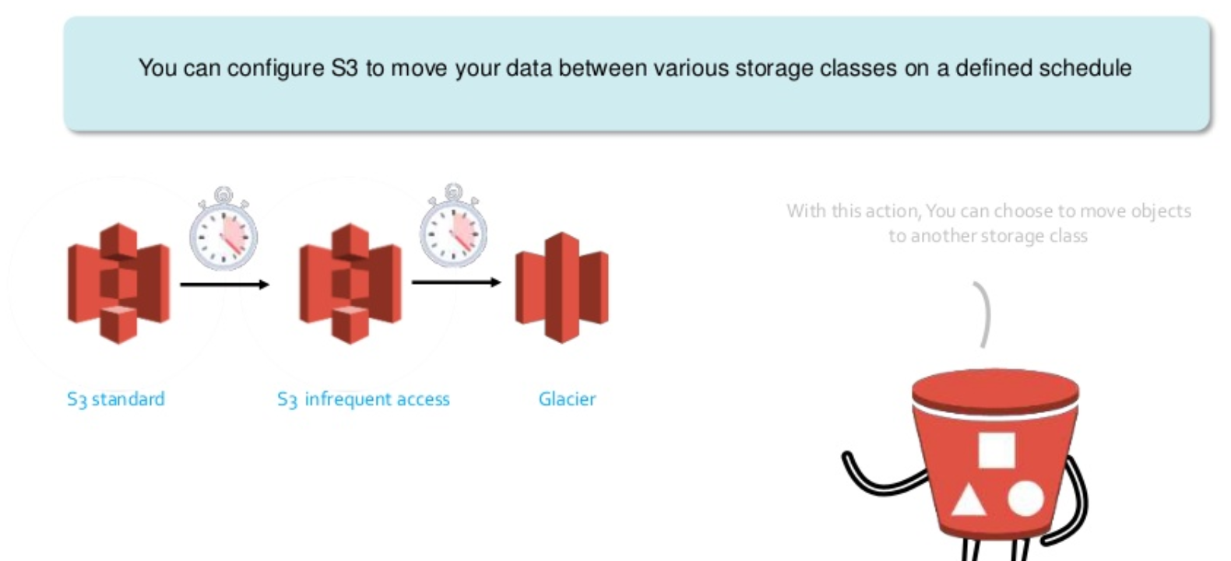
S3 – Life Cycle Management

Slide 16
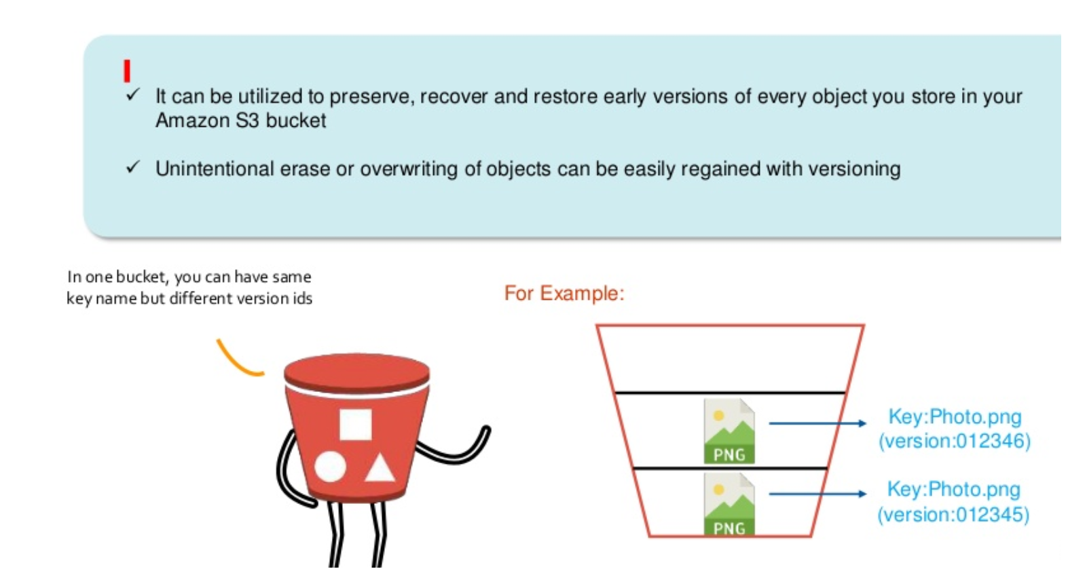
S3 – Versioning

Slide 17
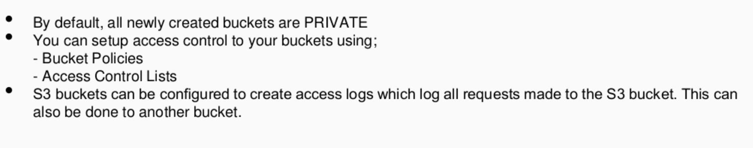
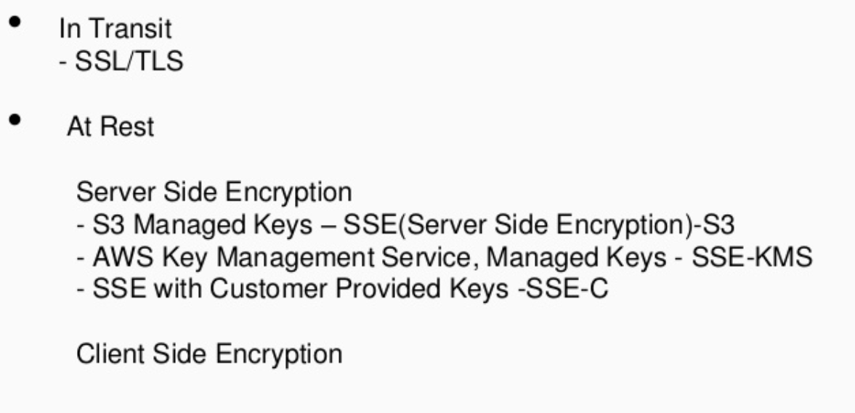
S3 – Security and Encryption

Slide 18
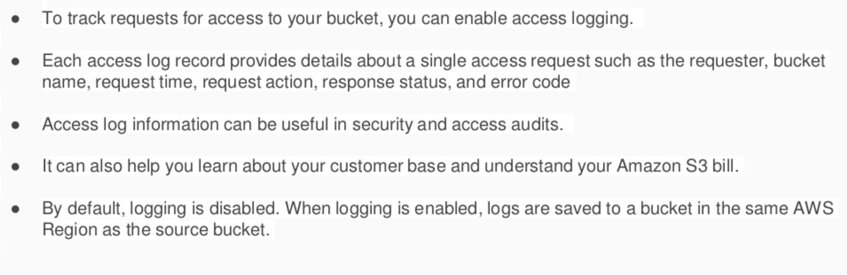
S3 – Server Access Logging

Slide 19
S3 –Naming Convention
Every Amazon S3 object can be addressed by a unique URL i.e.
https://<bucketname>.s3.amazonaws.com/<objectname>
https://<bucketname>.s3.amazonaws.com/<folder1>/<sub-folder>/<objectname>
We can access using below URL also
https://s3-<region>.amazonaws.com/<bucketname>/<objectname>
Static Website naming convention
<bucket-name>.s3-website-<region>.amazonaws.com

Slide 20
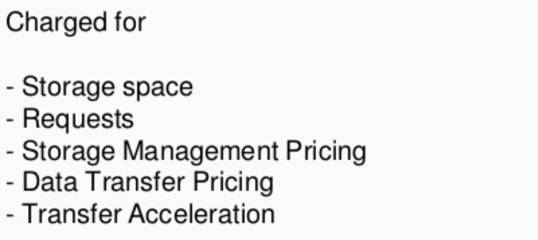
S3 – Cost

